Slide 1


Development of MCQ System
Module Project
Module: Programming Foundations
Course: Applied Degree in Software Engineering
: 11/16/2022
: 11/25/2022
11/26/2022
Learner Name
Enrollment ID
: Francis Roel L. Abarca
: BDSE-0922-113
Start Date :
End Date :
Submission Date :
Presentation Date :

Slide 2

Document History
Version Number | Effective Date of release | Summary of Included Changes | Author
1 | 22 Nov 22 | First Edition | Francis Abarca

Slide 3
Contents
Project Definition
Project Deliverables
Project Milestones & Tasks
Project Environment
Tools
Project Design
Classes & Methods
Steps from Coding to Execution
Development Process
Coding Standards
Milestone Feedback & Action Taken
Project Results
Proposed Improvements

Slide 4
1. Project Definition
Project Objective
The objective of this project is to create a Command-line style MCQ type of test program using the Java Programming Language and taking advantage of its object-oriented programming features. Make this program an easy way to use for students for quizzes.
Proposed Solution
▪ Create an MCQ style quiz using Java’s Classes and Object-oriented programming features.
Utilize the .CSV format for questionnaires for easy questionnaire creation and management.
Include a score percentage and score counter for real-time grading.
Include a motivational quote on startup of the program.

Slide 5
2. Project Deliverables
Initiation - Project Requirements
Planning - Creation of the Algorithm Diagram
Execution - Creation of the Algorithm itself - Coding
Testing - Testing of the code in the real world
Closing

Slide 6
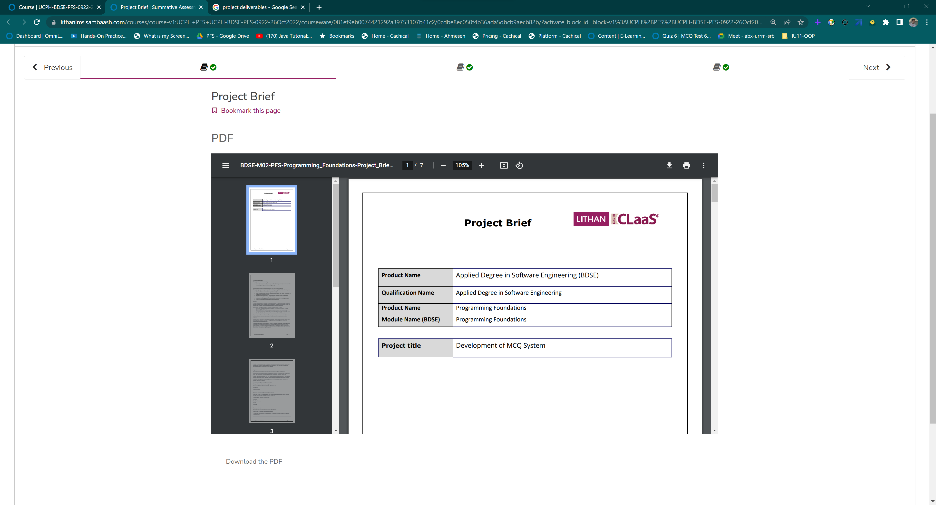
2. Project Deliverables
Initiation

Slide 7
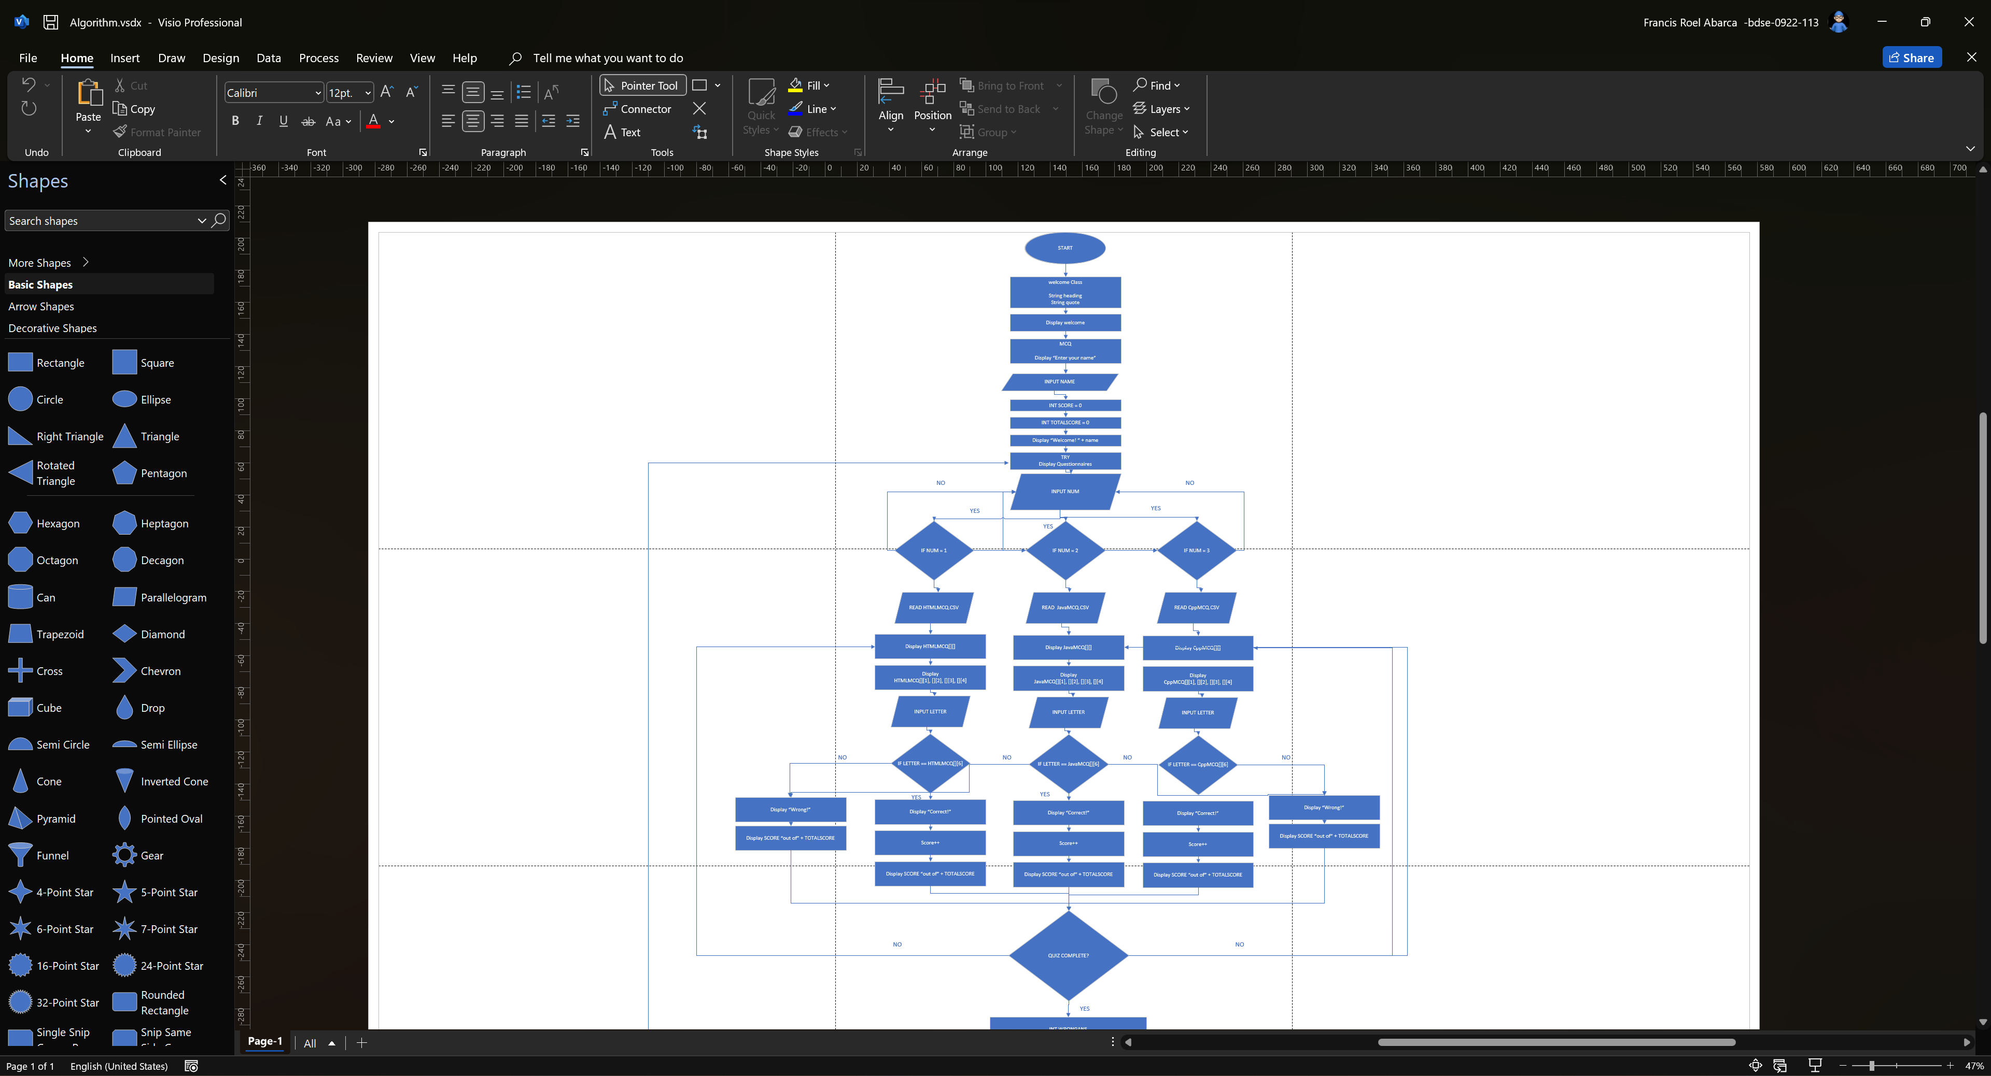
2. Project Deliverables
Planning

Slide 8
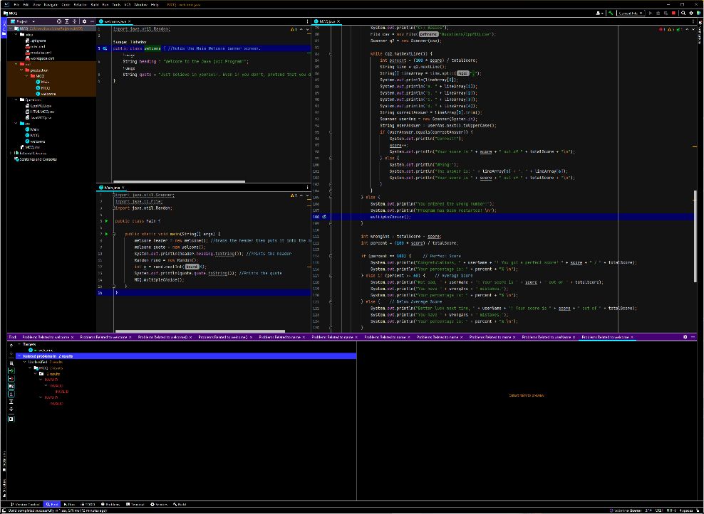
2. Project Deliverables
Execution

Slide 9
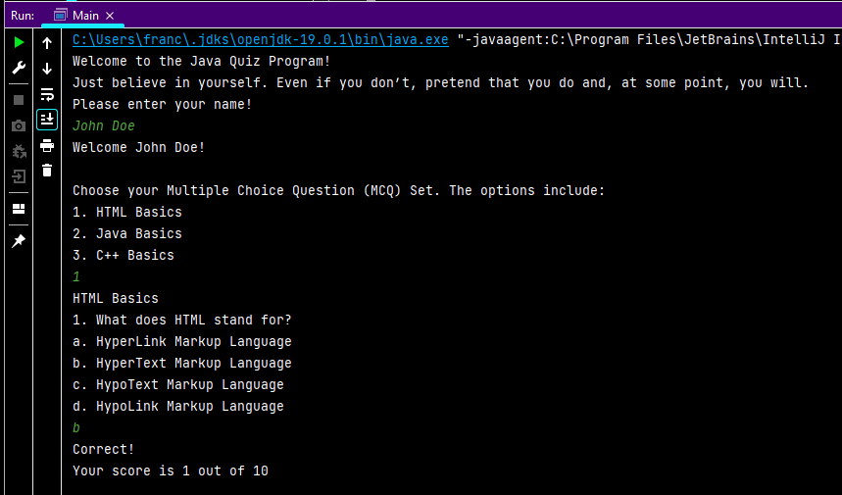
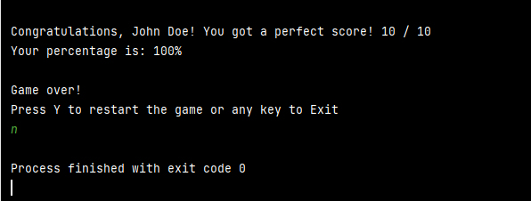
2. Project Deliverables
Testing

Slide 10
3. Project Milestones & Tasks
Project Task ID | Project Task Description | Project Milestone ID
1 | Create Requirement Specification | 1
2 | Develop Algorithm | 1
3 | Analysis and Design | 2
4 | Create the Application | 2
5 | Test the Application | 3

Slide 11
4. Project Environment
Technical Environment and Tools Used
JetBrains IntelliJ IDEA 2022.2.3
Windows 11 Pro 64-Bit
Ubuntu 22.04.1 LTS 64-Bit
macOS Ventura 13.0
Windows Terminal
List of references
https://www.javatpoint.com/java-mcq
https://www.sanfoundry.com/java-questions-answers-freshers-experienced/
https://www.interviewbit.com/html-mcq/
https://www.sanfoundry.com/cplusplus-interview-questions-answers/
https://www.javatpoint.com/how-to-read-csv-file-in-java
https://examstudyexpert.com/inspirational-exam-quotes/

Slide 12
5. Tools
IntelliJ IDEA

Slide 13
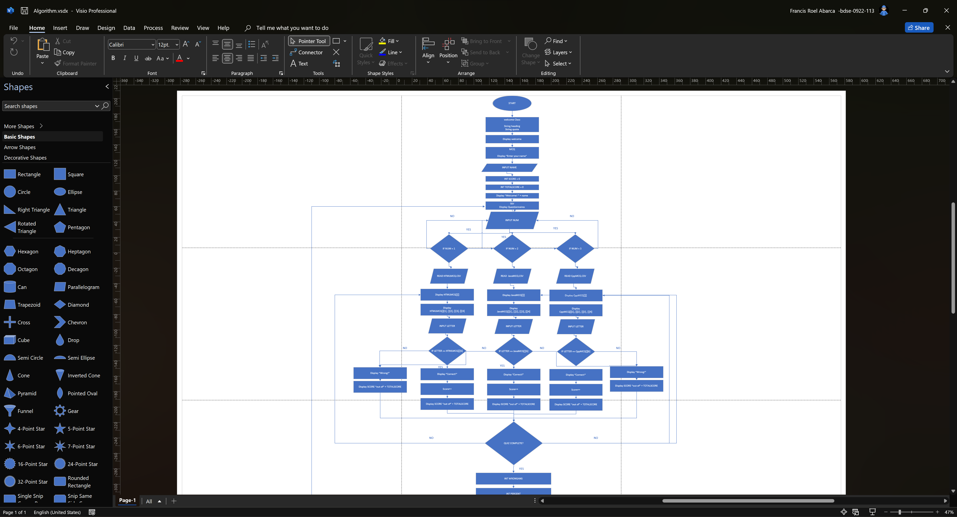
5. Tools
Microsoft Visio

Slide 14
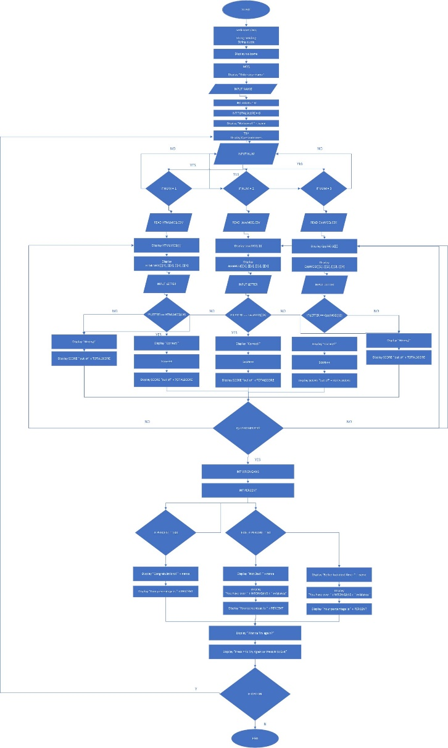
6. Project Design
System Design

Slide 15

6. Project Design
System Design

Slide 16
6. Project Design
System Design

Slide 17
6. Project Design
System Design

Slide 18
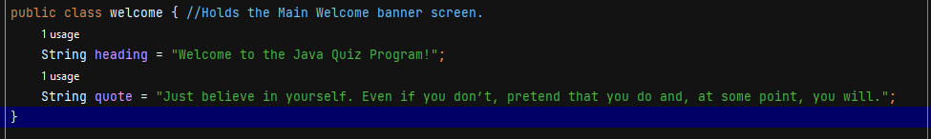
7. Classes & Methods
Class welcome

Slide 19
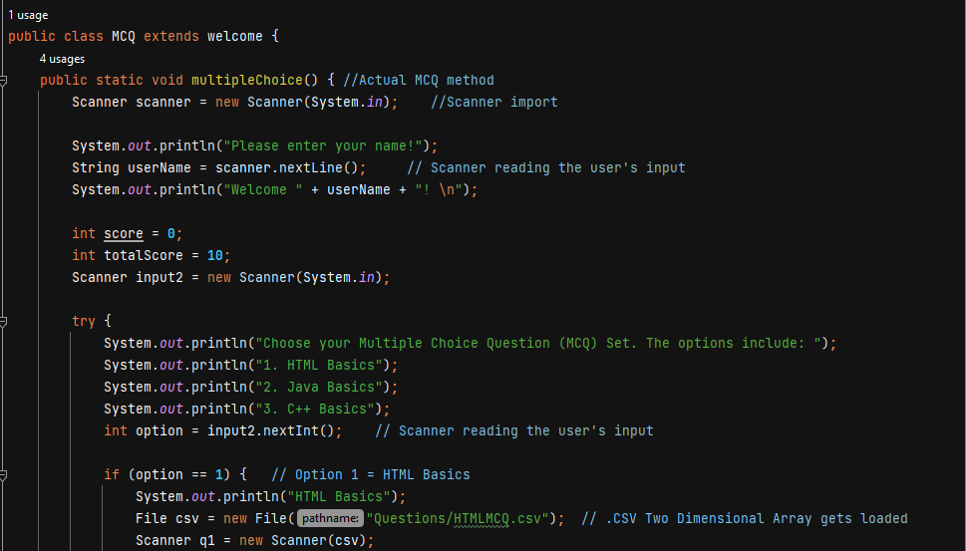
7. Classes & Methods
Class MCQ

Slide 20
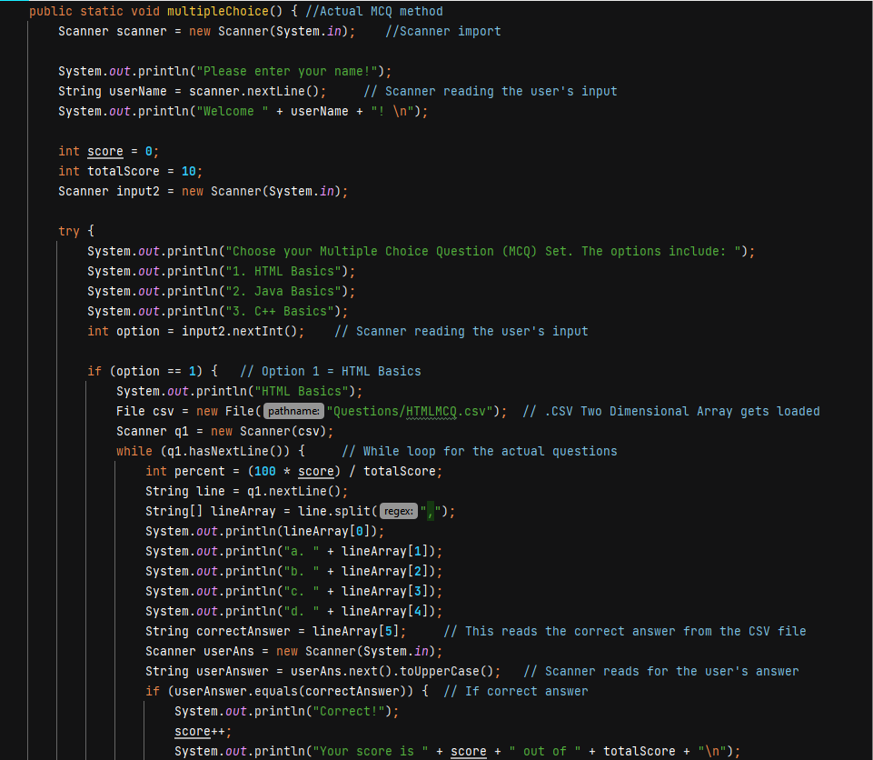
7. Classes & Methods
Method multipleChoice

Slide 21

8. Steps from Coding to Execution
Make a .CSV file containing the questions and answers on a database or spreadsheet software. This acts as the array for your questions.

Slide 22

8. Steps from Coding to Execution
2. Import the .CSV files onto one of the test options in the code.

Slide 23
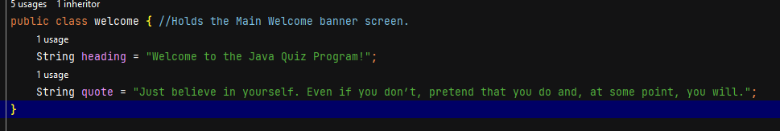
8. Steps from Coding to Execution
3. Create a welcome class which stores the splash screen for the program.

Slide 24
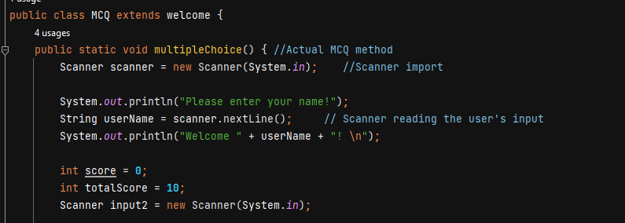
8. Steps from Coding to Execution
4. Create a class called MCQ then make a multipleChoice void method.

Slide 25
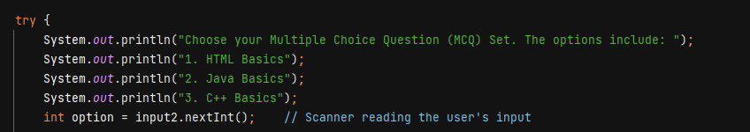
8. Steps from Coding to Execution
5. Add a try-catch syntax to your code then create an integer variable that reads the input from the user.

Slide 26
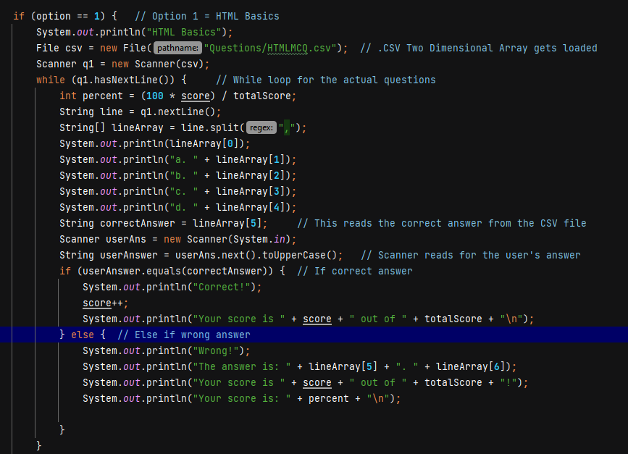
8. Steps from Coding to Execution
6. Create 3 If else options for each of the .csv questions.

Slide 27
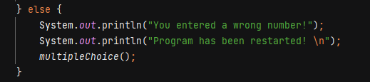
8. Steps from Coding to Execution
7. Add an else command at the end

Slide 28
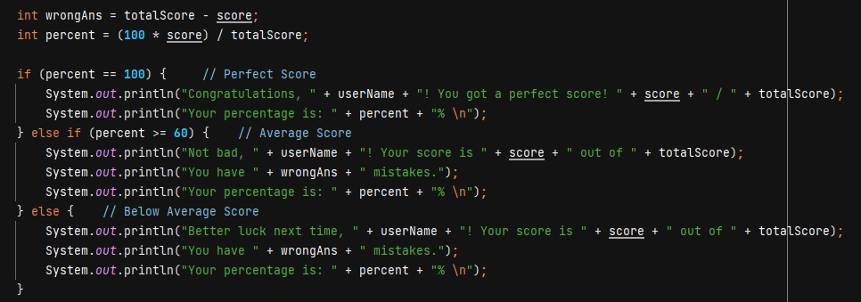
8. Steps from Coding to Execution
8. Add a Scoring system algorithm onto the end of the MCQ code.

Slide 29
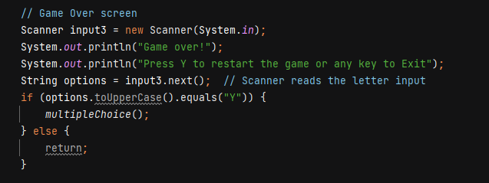
8. Steps from Coding to Execution
9. Add a game over menu.

Slide 30
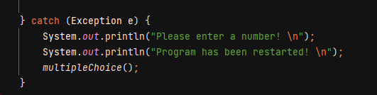
8. Steps from Coding to Execution
10. At the end, add a catch exception.

Slide 31
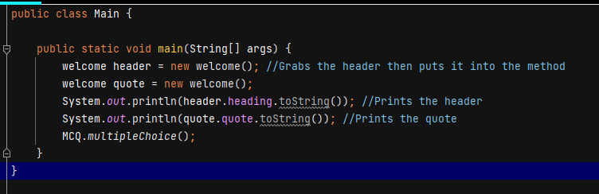
8. Steps from Coding to Execution
11. Import all the classes and methods onto main.

Slide 32
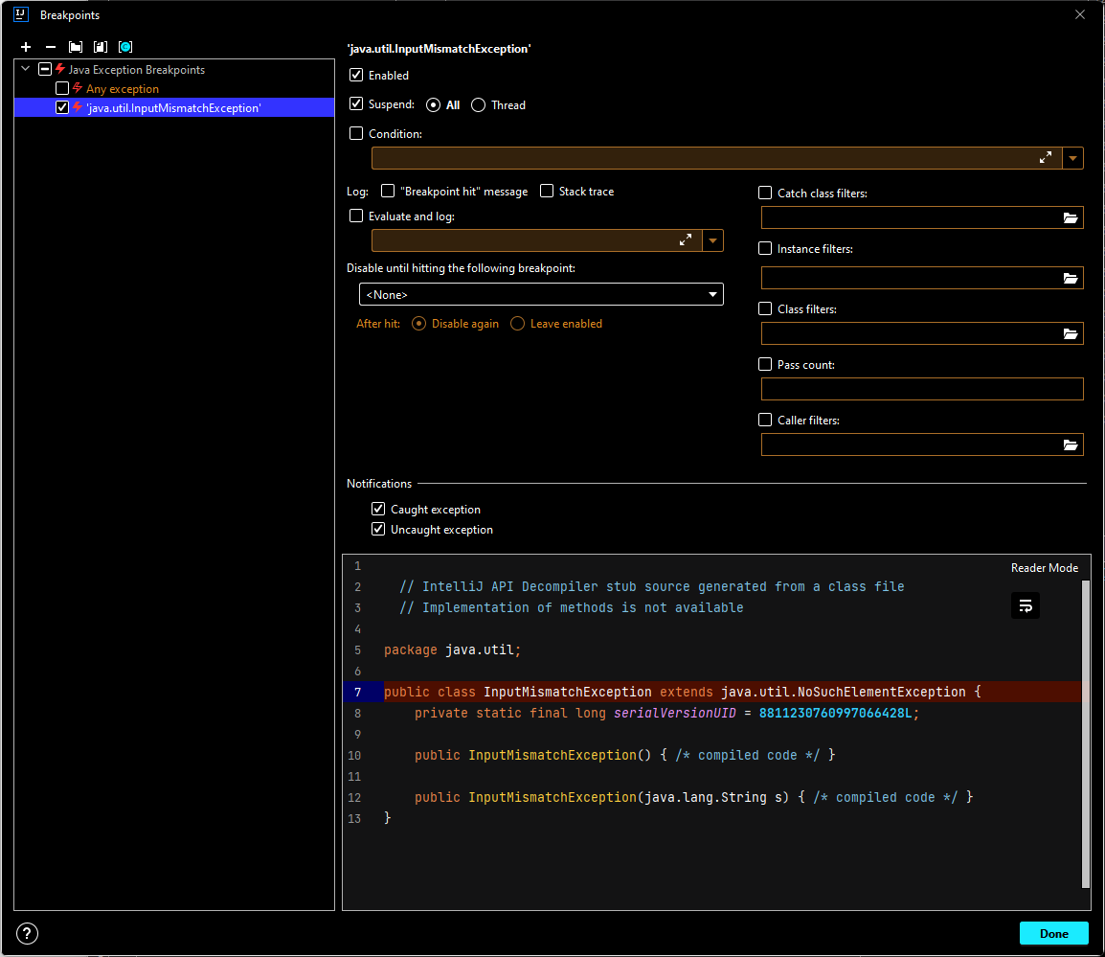
9. Development Process
We managed the development process by first planning out the algorithm itself on a flowchart piece by piece then we followed the list of Coding Standards to ensure that our code meets the right standards then the coding is done right after. During the process, it was compiled with us reading the documentation multiple times to get the desired variable we need and make use of it on our code. We utilized the IDE’s Find feature and tiled windows for maximum efficiency.

Slide 33
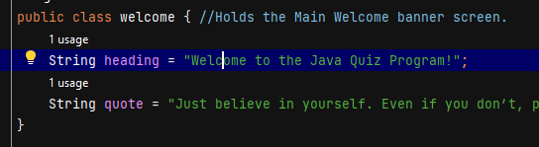
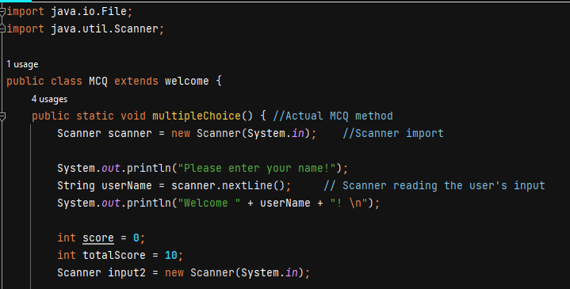
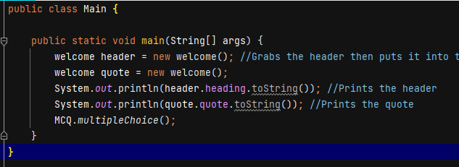
10. Coding Standards
Code Readability
The code of the program utilizes a series of variables that are basic and understandable to a novice programmer which helps in code replication and understanding.

Slide 34
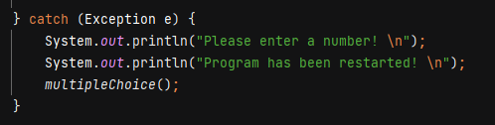
10. Coding Standards
Utilization of Exception Handling
The main codebase of MCQ utilizes Exception Handling to prevent any catastrophic errors that may damage the usability of the code and better understand the end user as to what the issue is when it does happen. The main code for the MCQ test is enclosed in a try-catch block for exception handling purposes.

Slide 35
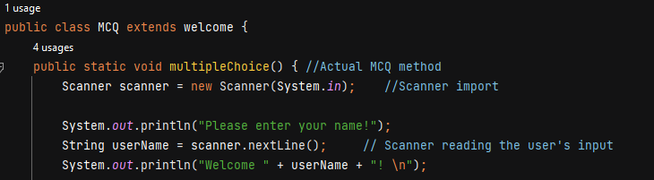
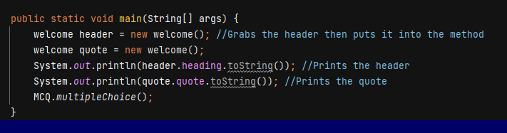
10. Coding Standards
Adding brief comments to the code
The codebase of this project heavily utilizes comments that briefly explain the purpose of one of the master lines on the code which can also help in replication together with Code Readability.

Slide 36
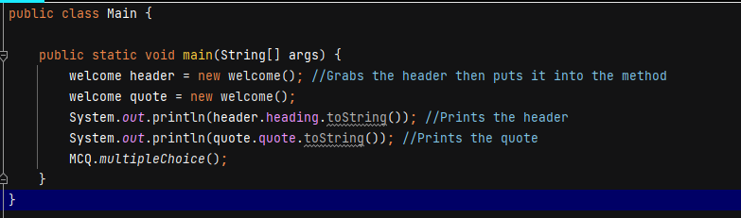
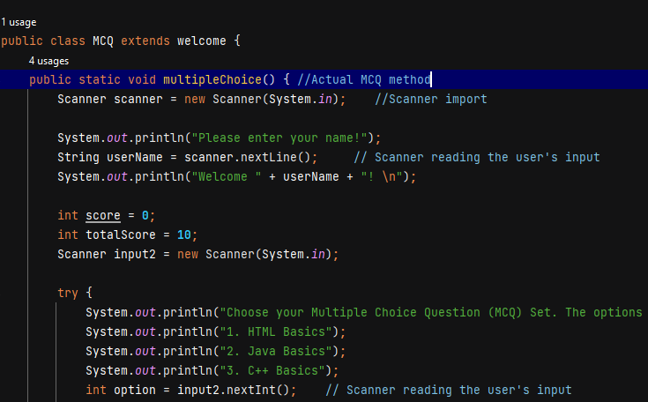
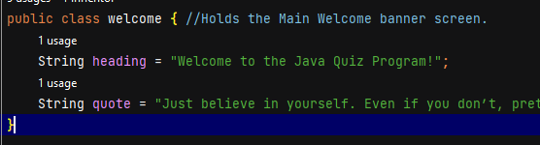
10. Coding Standards
Separating the code’s methods and classes
Specifically, this codebase utilizes separate methods and classes for the ease of modification and management during maintenance and debugging.

Slide 37
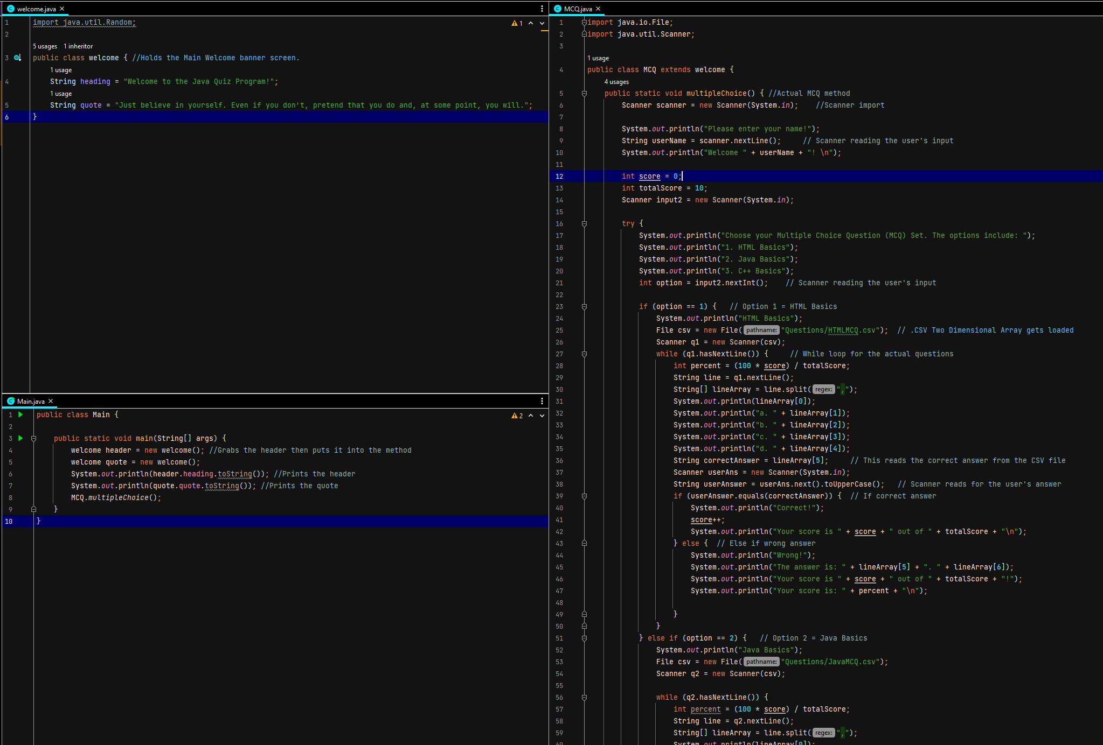
10. Coding Standards
The use of Standard Libraries in Java
This program utilizes the standard Java Library which makes the program super easy to replicate and run since pretty much the program’s library is available in every JRE that everyone uses.

Slide 38
11. Milestone Feedback & Action taken
Project Milestone ID | Milestone Feedback received from Tutor / Learning Facilitator | Action Taken (Yes / No)
1
2
3

Slide 39
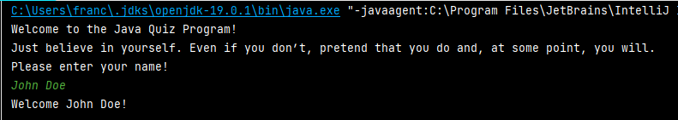
12. Project Results
Splash Screen

Slide 40
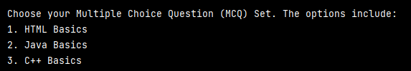
12. Project Results
Questionnaire Selection

Slide 41
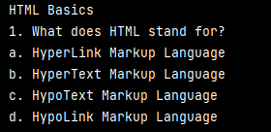
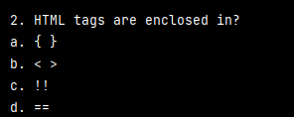
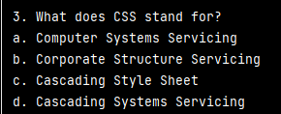
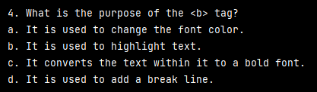
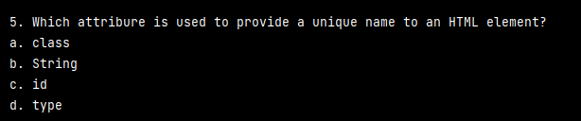
12. Project Results
Questions itself

Slide 42
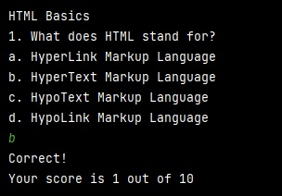
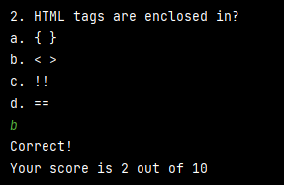
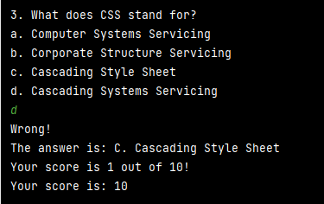
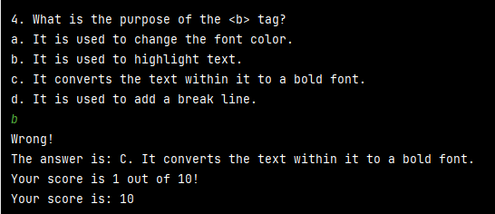
12. Project Results
Answering and Score System

Slide 43



12. Project Results
Score Tallying System

Slide 44

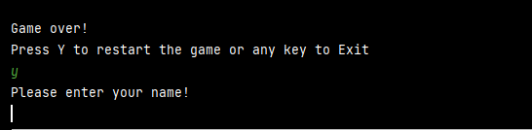
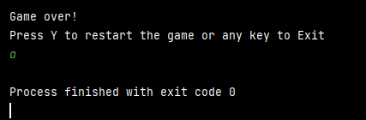
12. Project Results
End Prompt Screen

Slide 45
13. Proposed Improvements
List of Improvements
Utilize more of Java’s OOP capabilities.
Utilize Java’s Swing capabilities to create a GUI version of the MCQ test.
Add a Grading System that saves the grades of the user onto a .csv file.
Store the MCQ files on the internet and deletes it after the program is terminated.
Add support for Java’s Random utility for rearranging the questions on a given test.
Use an array of quotes together with the random utility to have quotes shuffle and change every time the program is launched.

